Slide 1
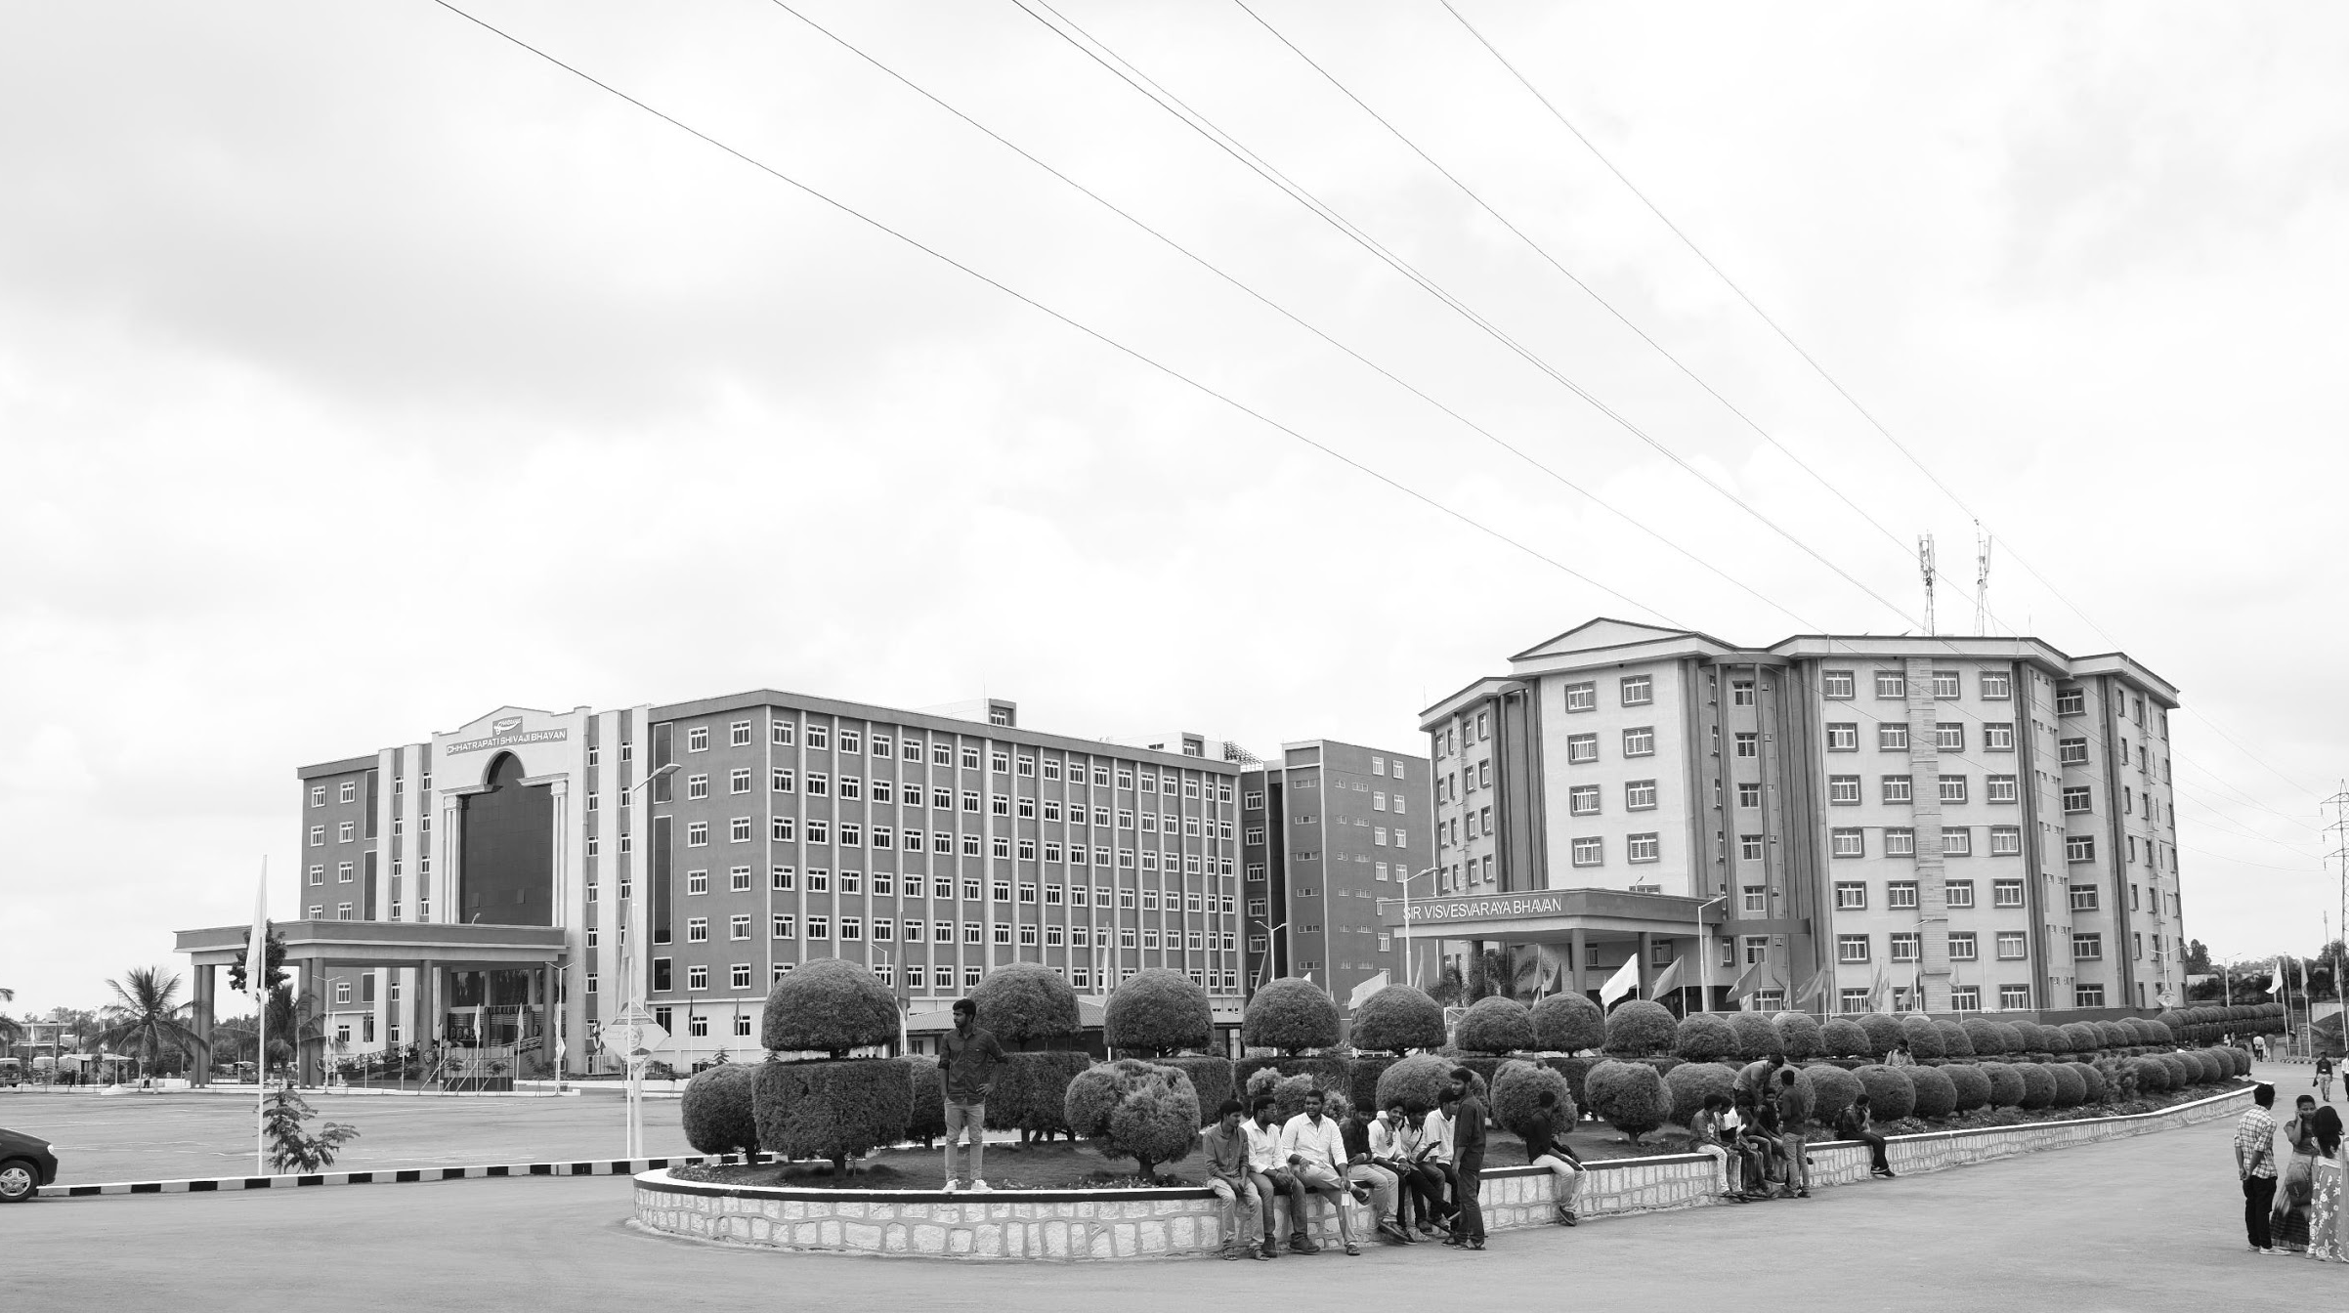

“Future of Farming: IoT-powered smart Agriculture system.”
Mid-Review: 3
Final Review.
Major Project.
Project ID: C13.
AY 2021-25
GITAM (Deemed-to-be) University
Project Team:
P. Vishnu Vardhan Reddy BU21EECE0100446
Samarjeet Kumar BU21EECE0100265
Ravindra Ganni BU21EECE0100495
Department of Electrical Electronics and Communication Engineering
Project Mentor:
Dr. Subhashish Tiwari
Project In-charge:
Dr. M. Arun Kumar

Slide 2
Objective and Goals:
Objective
The future of farming lies in IoT-powered smart agriculture systems that revolutionize traditional practices by integrating IoT devices and sensors for real-time monitoring of parameters like temperature, humidity, soil moisture, and light intensity. These systems enable precision farming, optimizing resource use, automating processes, and providing predictive insights through data analytics. By reducing waste, enhancing productivity, and promoting sustainability, IoT-driven agriculture addresses global challenges like food security and climate change, paving the way for a more efficient, connected, and eco-friendly farming landscape.
Goals
Optimize Resource Utilization
Enhance Crop Productivity
Real-time Monitoring Reduce
Environmental Impact Increase
Farm Profitability

Slide 3
Abstract
The integration of IoT technology into agriculture is revolutionizing farming by enabling real-time monitoring of environmental conditions, soil health, and crop growth, resulting in enhanced productivity and reduced resource wastage. Key innovations include microclimate-specific farming, where IoT devices analyze hyper-local conditions, allowing precise resource allocation to maximize efficiency and yield. Dynamic plant bio-response monitoring uses IoT to track real-time physiological signals from crops, enabling adaptive interventions that optimize growth conditions and improve overall productivity.
Additionally, blockchain integration within IoT frameworks ensures transparent, tamper-proof supply chains, fostering trust among producers and consumers while providing reliable information on food origins and quality.
The project also incorporates autonomous crop breeding systems, leveraging IoT and AI to automate the development of high-yield, climate-resilient crop varieties, significantly reducing the time and resources needed for breeding. Furthermore, collaborative decentralized farming platforms empower small-scale farmers by offering access to shared infrastructure, real-time data, and collective insights, encouraging cooperation and boosting productivity.
This IoT-powered agriculture system addresses critical global challenges like food security and climate resilience while fostering sustainable and efficient farming ecosystems. By combining cutting-edge technology with traditional farming practices, this initiative aims to enhance resource efficiency, improve crop quality and quantity, and establish transparent supply chains, ensuring a sustainable and prosperous future for farmers worldwide.

Slide 4
Project plan
Phase: | Month 1 | Month 2 | Month 3 | Month 4 | Month 5 | Month 6
Research & Conceptualization (Finalize project scope, study IoT, AI, Blockchain, farming needs) | ████ | ████
Design & Prototyping (Develop system architecture, prototype sensors, AI & blockchain models) |  | ████ | ████
Pilot Testing (Deploy IoT devices on farms, collect feedback, refine technology) |  |  |  | ████ | ████

Slide 5
Project plan
Phase: | Month 1 | Month 2 | Month 3 | Month 4 | Month 5 | Month 6
System Refinement & Scaling (Optimize IoT, AI, blockchain systems, expand decentralized platform) |  |  |  |  | ████ | ████
Full-Scale Implementation (Deploy system at large scale, monitor & evaluate performance) |  |  |  |  |  | ████

Slide 6
Literature survey
Study/Author(s) | Year | Focus/Objective | Technologies Used | Key Findings/Contributions
Kumar, A. et al. | 2023 | IoT, Cloud Computing, Sensors | Arduino, soil moisture sensors, Wi-Fi | Real-time monitoring of soil moisture, temperature, and humidity using IoT devices, predictive analytics for irrigation management
M. Kumar and R. Kaur | 2018 | Precision agriculture using IoT | Raspberry Pi, DHT11, soil sensors | Developed a system for real-time monitoring of temperature, humidity, and soil moisture, leading to better crop management.
Shaikh Sayeeda Gulab | 2023 | IoT-based greenhouse monitoring | Wireless sensor networks, ZigBee | Enabled remote monitoring and control of greenhouse conditions, improving crop health and reducing energy consumption.
Singh & Gupta | 2022 | "Classification and Yield Prediction in Smart Agriculture System using IoT" | IoT, Machine Learning (ML), Drone Tech | Use of IoT and drones for smart irrigation, pest detection, and automated crop monitoring using machine learning algorithms

Slide 7
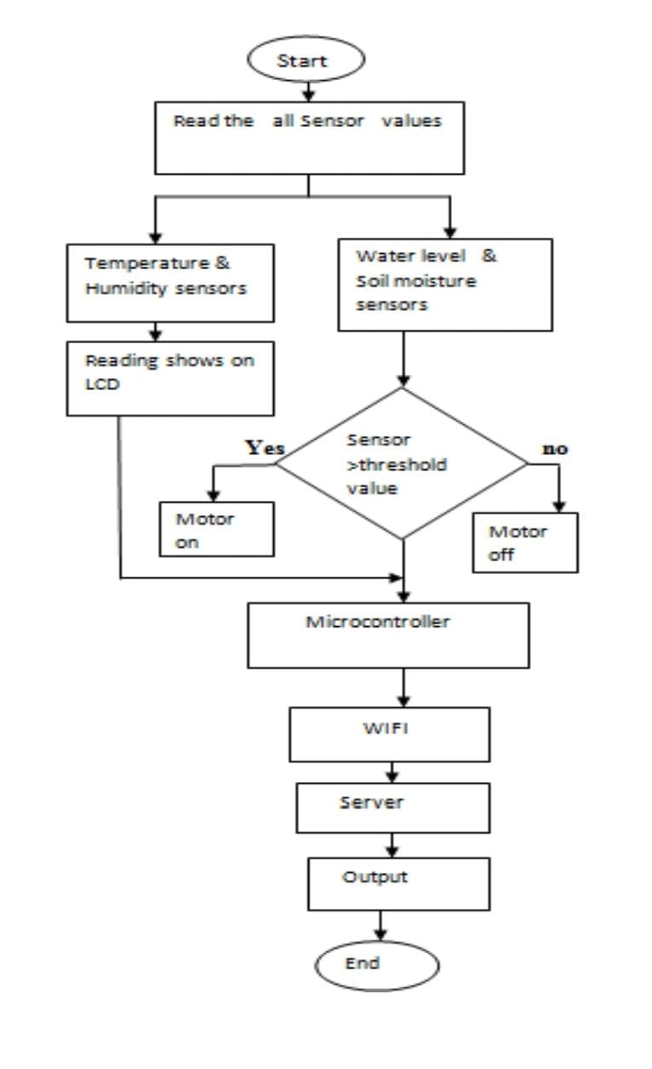
Architecture:

Slide 8
Use Cases & Testing:
Use Cases:
Automated Irrigation – Activates the water pump based on soil moisture levels to optimize water usage.
Real-Time Weather Alerts – Sends notifications for extreme temperature or humidity changes.
AI-Driven Crop Health Analysis (Future Work) – Predicts diseases and optimizes farming through data analytics.
Test Cases
Soil Moisture Sensor Accuracy – Validates sensor readings with actual soil conditions.
Wireless Communication Reliability – Ensures stable ESP32 connectivity with cloud services.
Water Distribution Efficiency – Tests pump activation/deactivation based on moisture thresholds.

Slide 9
Working Principle:
This diagram illustrates the architecture of an IoT-based smart agriculture system. Here’s a breakdown of the components and their interactions:
1. Wireless Sensors Network
Purpose: Collects real-time data (e.g., soil moisture, temperature, humidity, etc.) from the agricultural field.
Output: Sends data to the Cloud-based IoT Platform.
2. Farmer Data
Purpose: Inputs from farmers, such as crop type, irrigation preferences, and schedules.
Output: Sends actionable information to the Cloud-based IoT Platform.
3. Weather Forecast
Purpose: Provides weather information (e.g., rain, temperature changes) for intelligent decision-making.
Output: Sends data to the Cloud-based IoT Platform.
4. Cloud-based IoT Platform
Role: Acts as the central hub for data collection, processing, and decision-making.
Functions:
Analyzes data from sensors, farmers, and weather forecasts.
Sends actionable instructions to the NI CompactRIO Controller.

Slide 10
Implementation and Results – Iteration 1
Iteration 1: Prototype Development and Basic Sensor Integration:
Objective: Develop a working prototype with essential sensors and basic automation.
Implementation:
Assembled the hardware prototype using ESP32, DHT11, soil moisture sensor, ultrasonic sensor, and a 12V water pump.
Implemented sensor data collection and processing using ESP32.
Integrated a relay-based control system for automated irrigation based on soil moisture readings.
Powered the system using a DC-DC buck converter to regulate voltage levels.
Successfully tested real-time sensor readings and water pump activation.
Results:
The system was able to detect temperature, humidity, and soil moisture levels accurately.
Automated irrigation successfully activated the water pump when moisture dropped below a threshold and turned it off once optimal moisture was reached.

Slide 11
Implementation and Results – Iteration 2:::
Iteration 2: Advanced Automation, Data Analytics, and Cloud Connectivity.
Objective: Enhance automation features, enable real-time remote monitoring, and analyze farm data.
Implementation:
Connecting the system to a cloud platform (such as Blynk) for remote data visualization.
Developing a web dashboard to display real-time temperature, humidity, and soil moisture readings.
Implementing data analytics to study environmental trends and predict irrigation needs.
Optimizing power consumption for energy-efficient operation.
Testing a mobile-based control system for farmers to monitor and control the irrigation remotely.
Expected Results:
Users can access live sensor data remotely via a mobile app or web dashboard.
The system can predict and optimize irrigation schedules based on data trends.
Improved energy efficiency through intelligent power management.

Slide 12
Implementation and Results – Iteration 3:
Iteration 3: AI-Based Analytics and Blockchain Traceability System:
Objective: Implement advanced AI-driven analytics and enhance transparency using blockchain.
Planned Implementation:
AI-powered analytics to predict soil conditions and crop health using machine learning models.
Blockchain-based food supply chain traceability for secure and transparent farming records.
Drone and IoT integration to enable precision farming and automated monitoring.
Weather API integration for real-time climate predictions to adjust farming strategies.
Expected Results:
AI-based predictions can help farmers prevent crop diseases and optimize resource use.
Blockchain integration ensures secure and transparent farm-to-market tracking.
The system evolves into a fully autonomous, self-sustaining smart farm model.

Slide 13
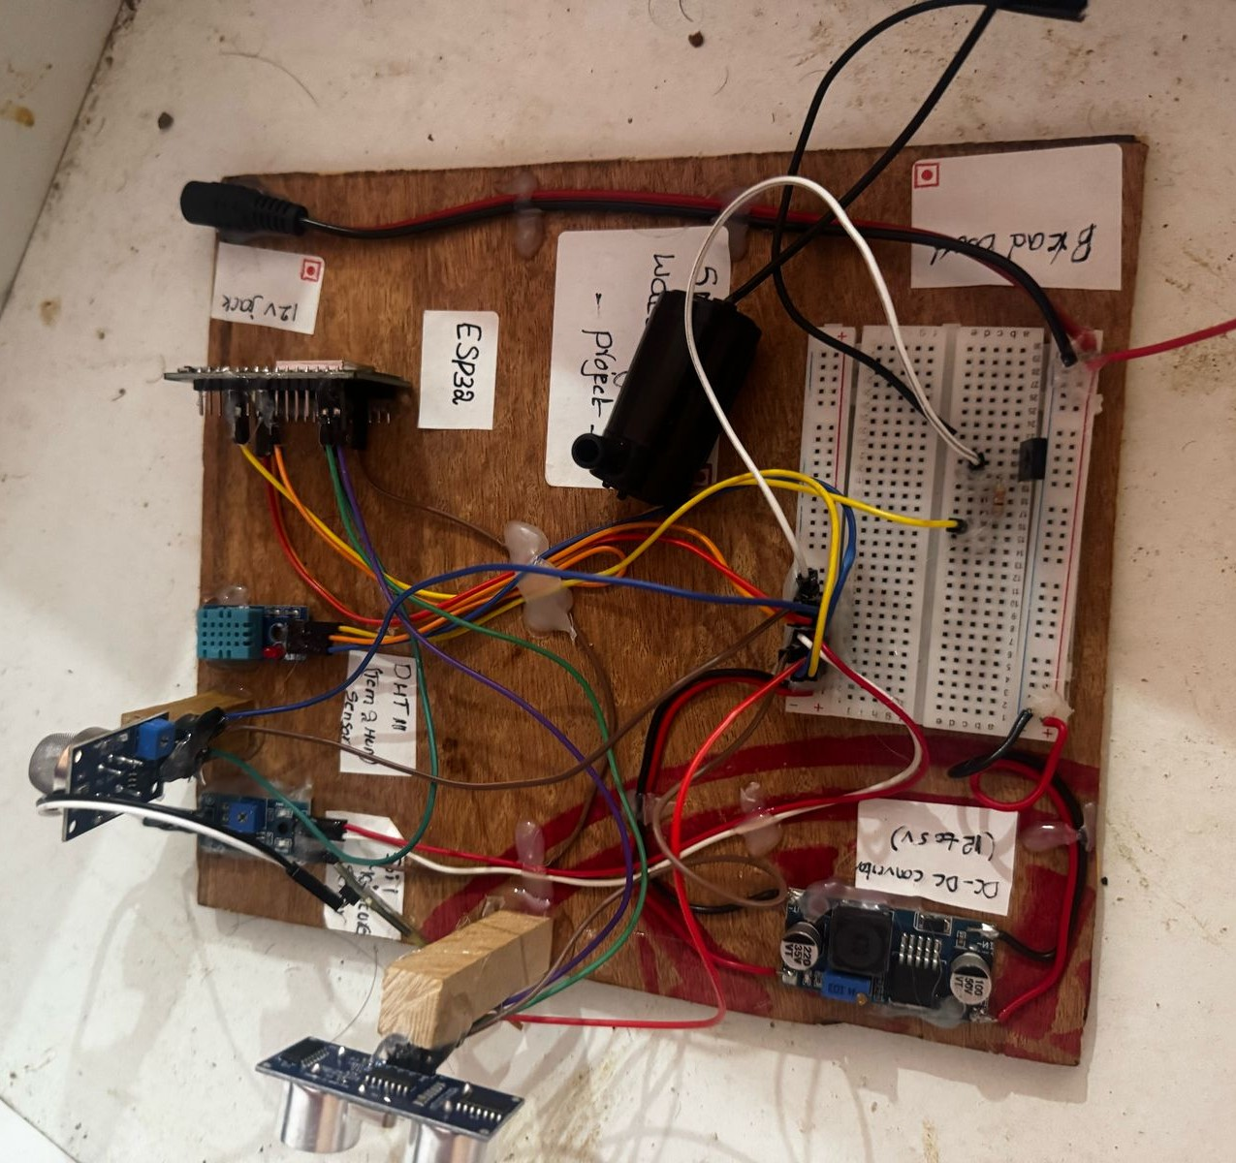
Model of the project:

Slide 14
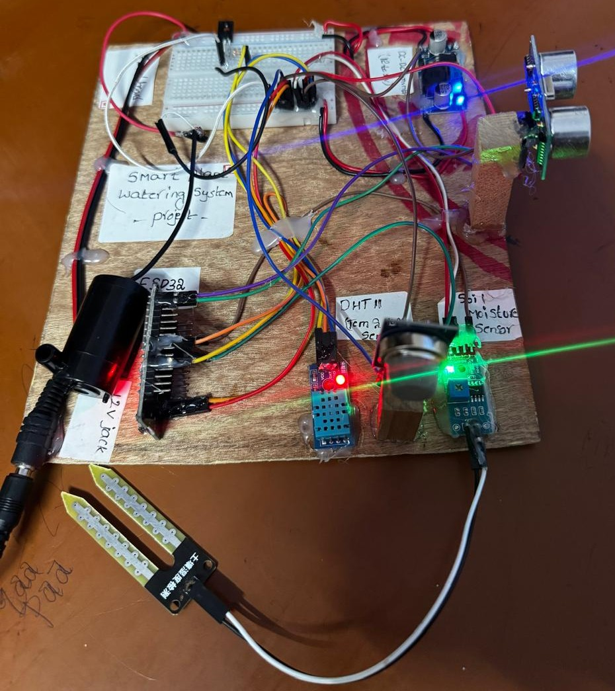
Working model:

Slide 15
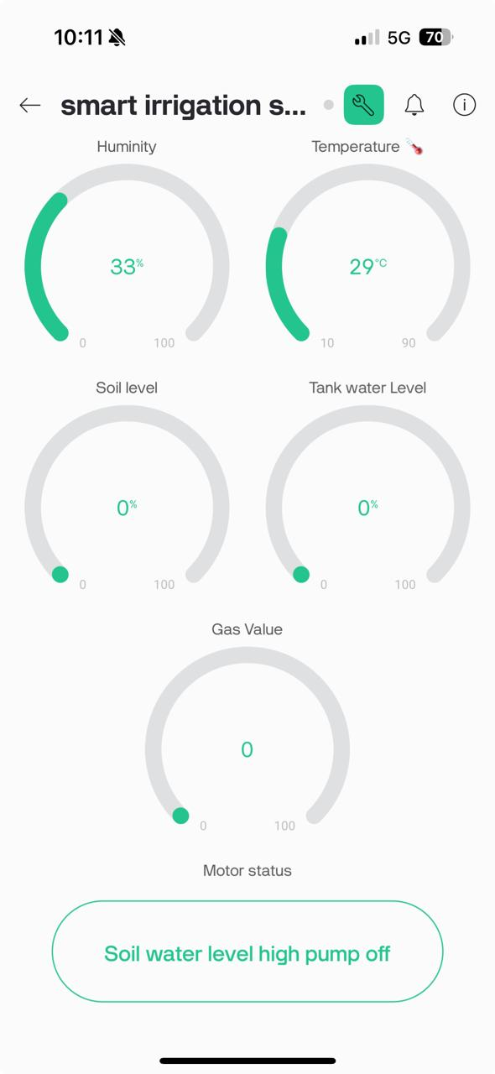
Readings:

Slide 16
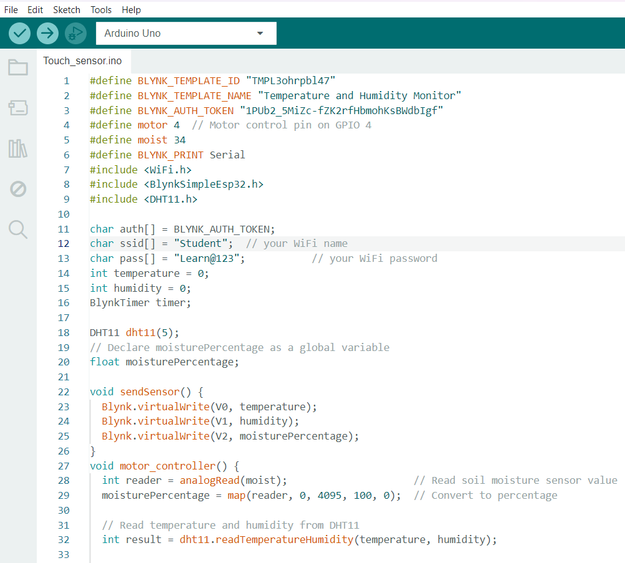
Code:

Slide 17
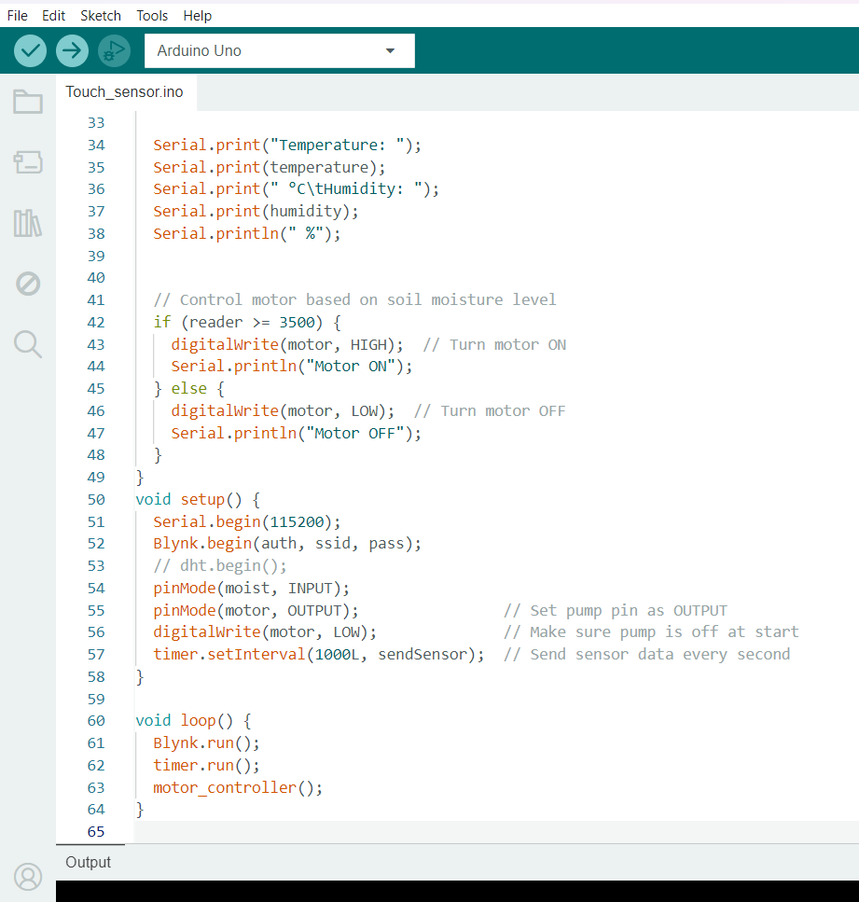
Code:

Slide 18
Conclusion & Future Work
Conclusion:
The development of a smart irrigation system using IoT technology offers a significant improvement in resource management and agricultural productivity. By integrating sensors for temperature, humidity, water level, and soil moisture with a microcontroller and cloud-based platform, the system ensures efficient water usage and reduces manual intervention. The automated control of pumps and other actuators based on real-time sensor data enhances precision in irrigation, leading to better crop yields and sustainability.
Future Work:
Microclimate-Specific Farming: IoT devices monitor hyper-local conditions, enabling efficient resource allocation for optimal crop growth.
Dynamic Plant Bio-Response Monitoring: Real-time tracking of crop physiological signals allows for adaptive interventions, enhancing growth conditions and productivity.
Blockchain Integration: Ensures transparent and tamper-proof supply chains, fostering trust between producers and consumers and providing reliable information on food origins.
Autonomous Crop Breeding Systems: IoT and AI technologies automate the creation of high-yield, climate-resilient crop varieties, reducing breeding time and resource consumption.
Collaborative Decentralized Farming Platforms: These platforms offer small-scale farmers shared infrastructure, real-time data, and collective insights, fostering cooperation and boosting productivity.

Slide 19
THANK YOU
Have a Great Day !

